Slide 1

Stat-gram
Micro-Services
Peter Brito
Hayes Martens
Millad Hazrati

Slide 2





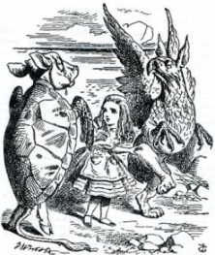











Technologies Used

Slide 3
Business Opportunity - Pipeline
Advertising
Leads-generate
Engagement
Conversion
Save money, Advertising for the right person
Increase number and quality of your leads
Many-Competitors
Many-Competitors

Slide 4
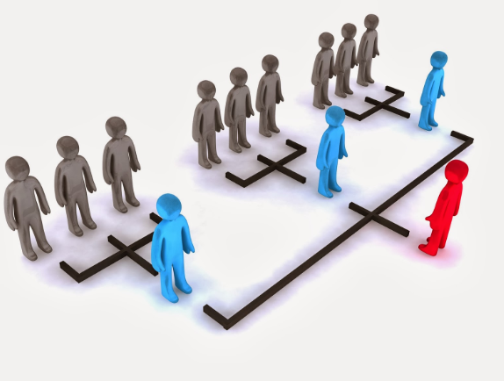
What make the Product Unique
NLP
Classification
Span Detector
Sentiment Analysis
Supervised Learning

Slide 5
Business Model
B2B
B2C
Scalable Market
Partnership (Ad and PM)
Easy Usability
Target: Influencers and Software Business
Market Introduction
UX, data-driven
Brand Recognition
Results-driven

Slide 6
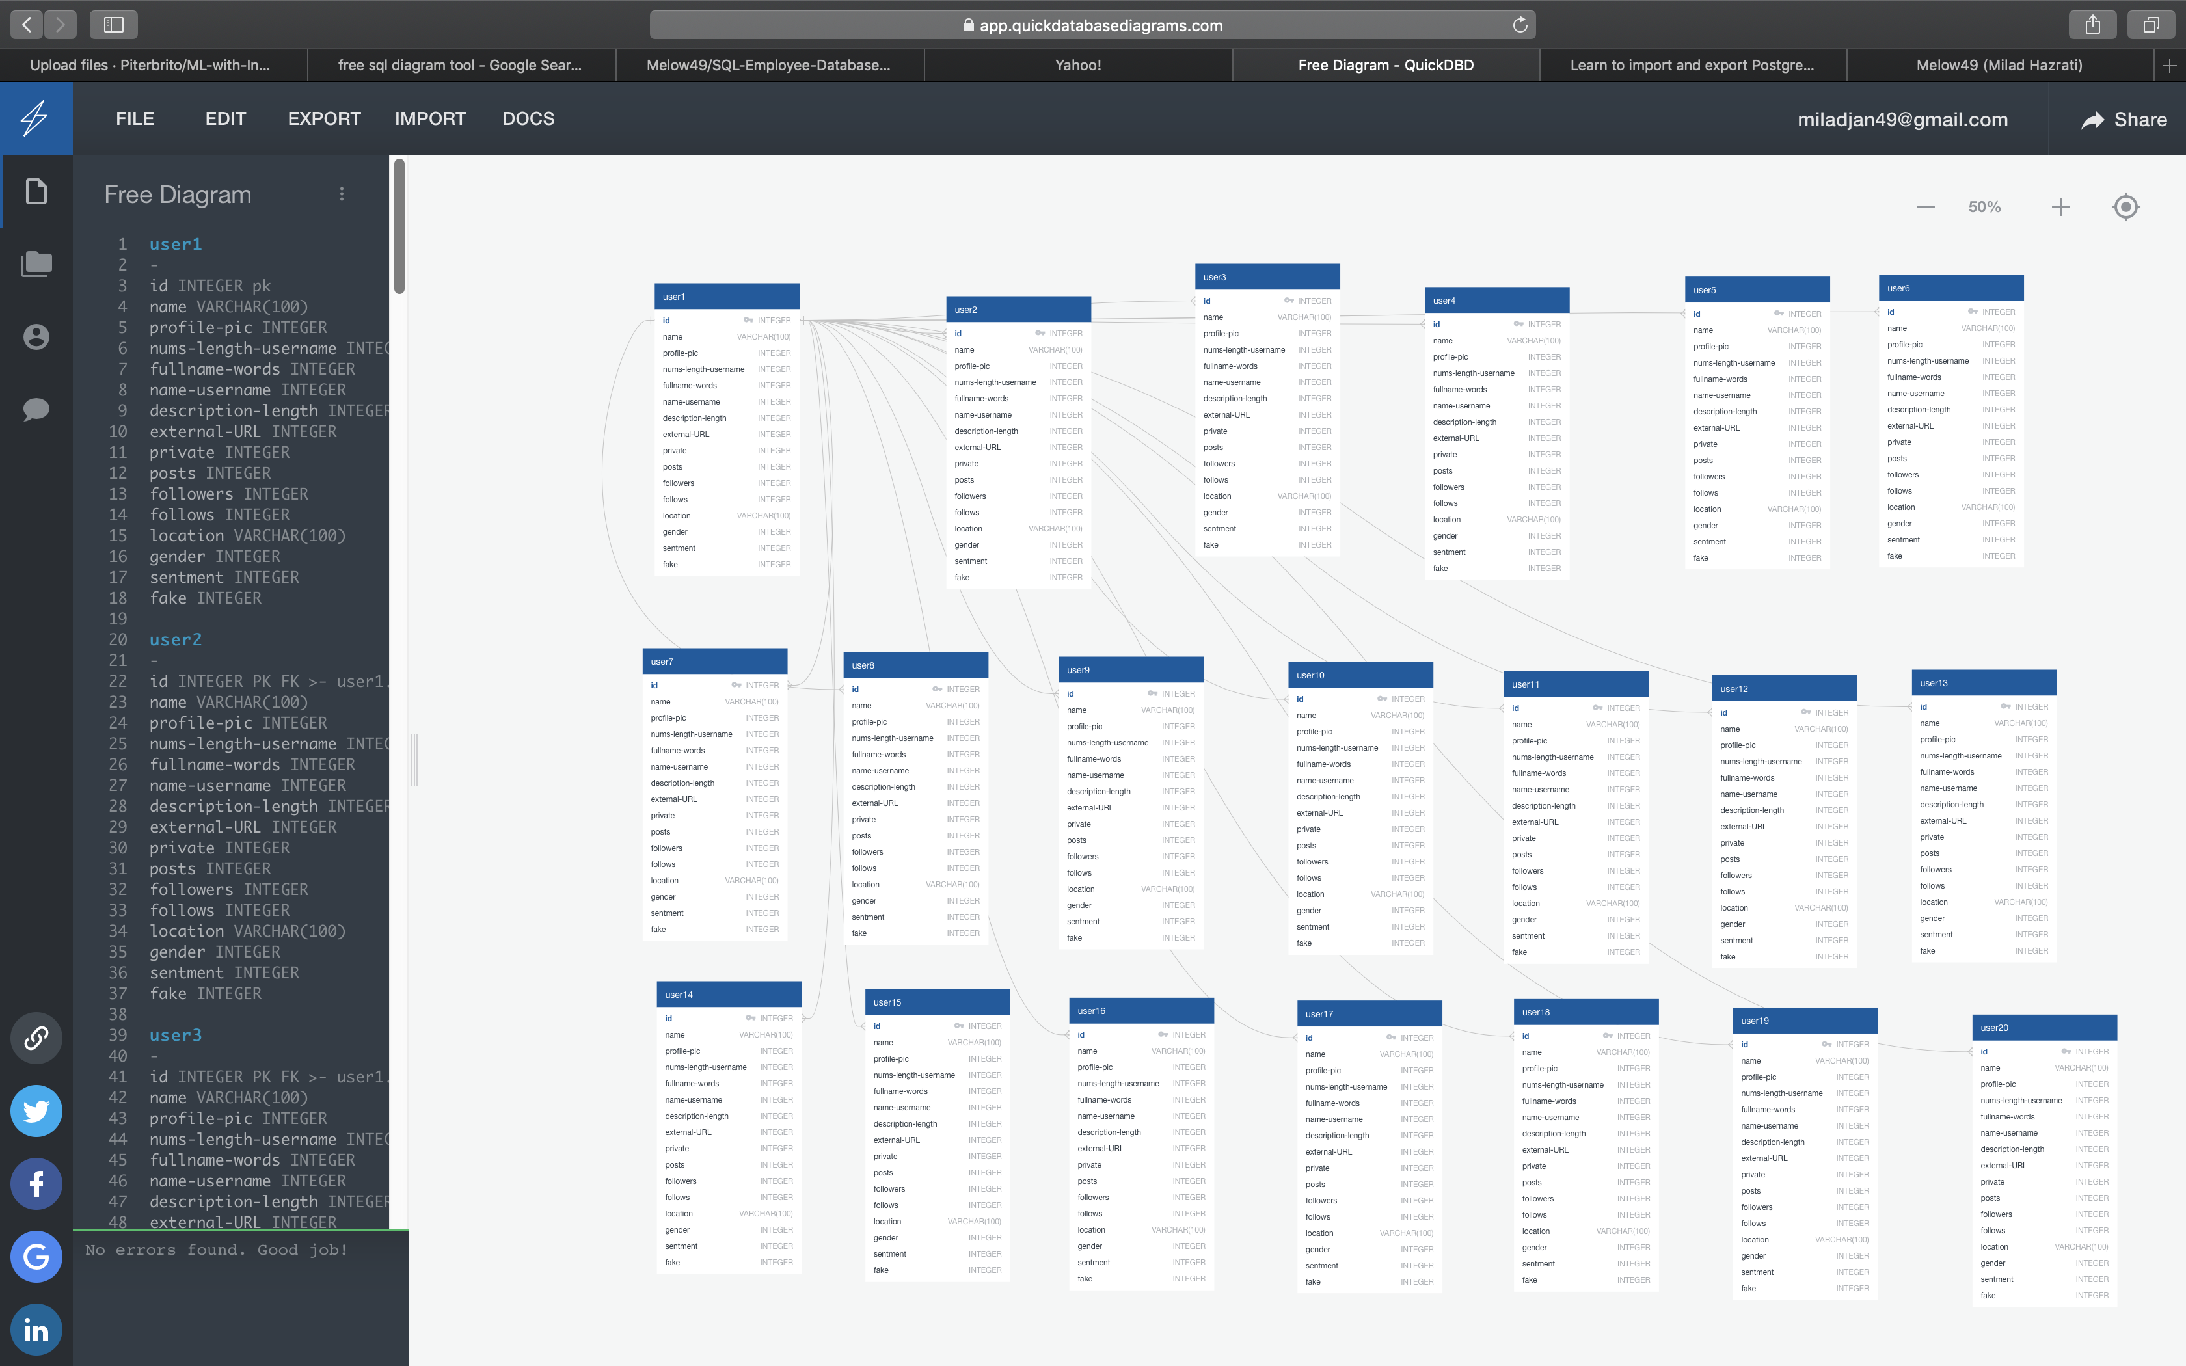
SQL database- Schema

Slide 7
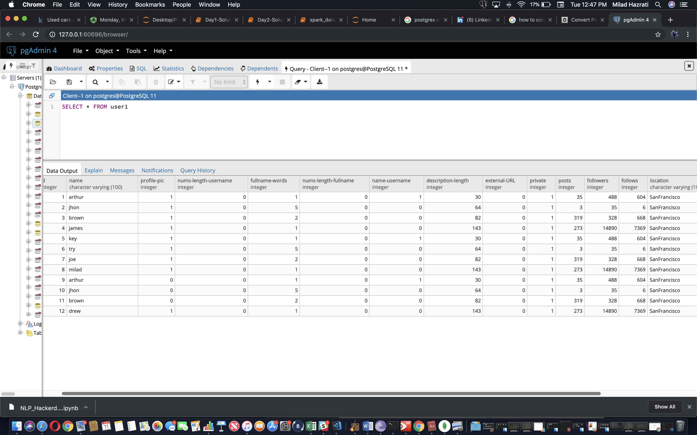
SQL database - Tables

Slide 8
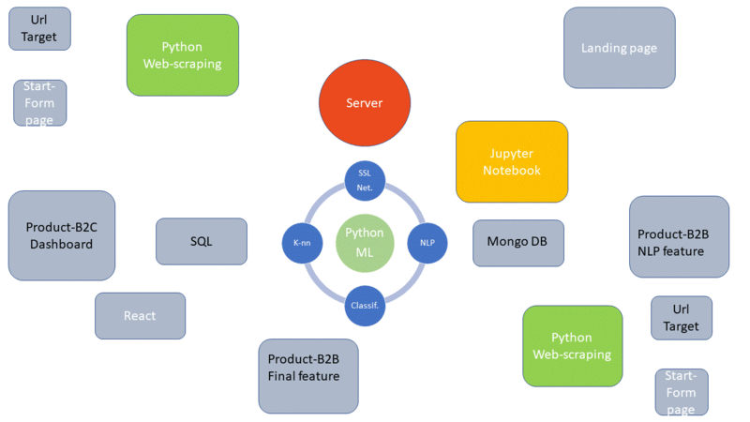
Software Architecture

Slide 9
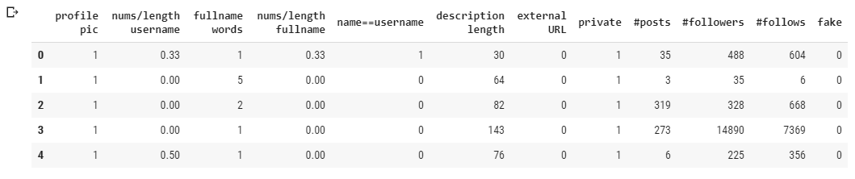
ML – Train Data

Slide 10
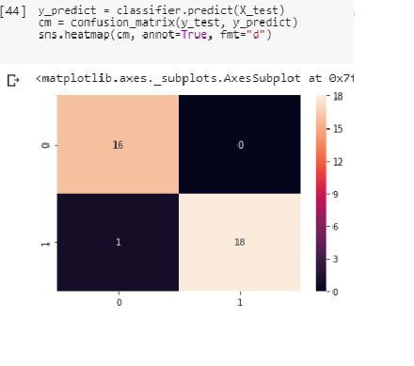
ML – K-nn Algorithm
Accuracy super High
?

Slide 11
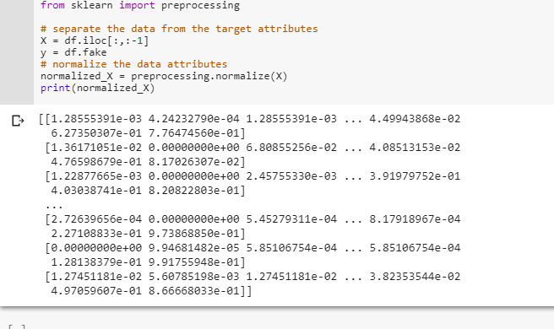
ML – Data-Normalization

Slide 12
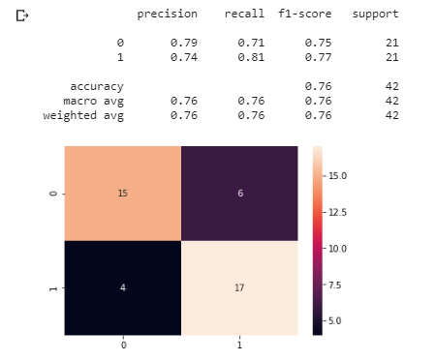
ML – Confusion Matrix
Accuracy dropped to normal, but still high for the parameters used

Slide 13
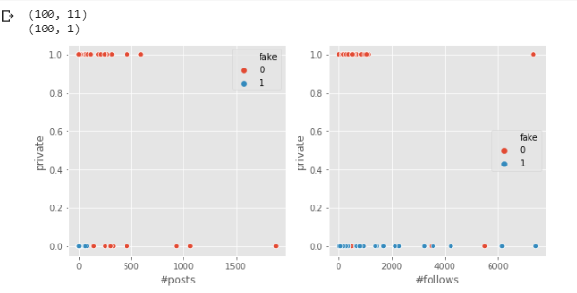
Inspecting the Data
All Fakes Profiles
are Public accounts.

Slide 14
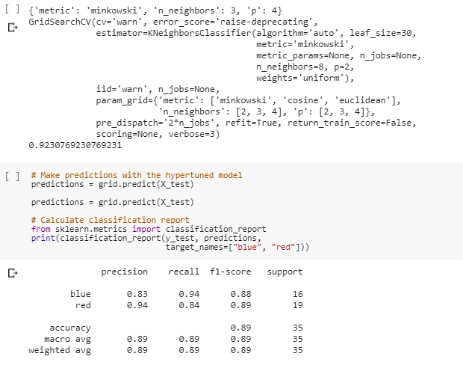
ML - Using Grid-Search
The Best set up is:
Metric: minkowski
N_neighbors: 3
P: 4

Slide 15
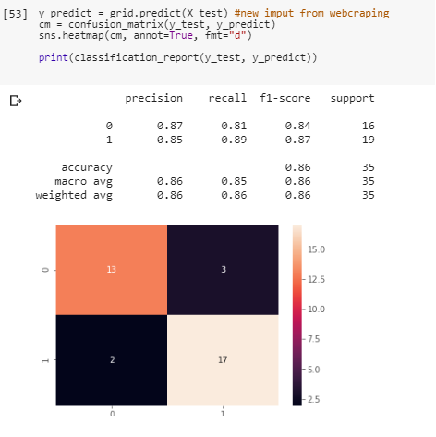
ML – Final Model-CF
Accuracy: 0.86
Predicted on the Test Data

Slide 16
PRODUCT DEMO…

Slide 19
Thanks..

Slide 20
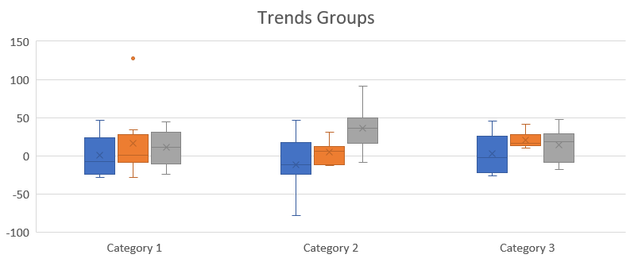
Dashboard ML
Possible Spans Profiles
Name
Name
Name
Name

Slide 21
Final Product
Instructions
Problem
Task
Action
Review, Step by step
Monitoring Generate Report, for Manager in charge
1
Step
2
Step
3
Step
Task
Action
Task
Action
Task
Action
Report
Report
Report
4
Step
5
Step
6
Step
Task
Action
Task
Action
Task
Action
Report
Report
Report

